Slide 1
Year 1
Curriculum Information
24th September 2024
Notes:
Flavours of Education
Systems not people
Capacity

Slide 2
General Information
Parent Drop-in Sessions:
Parents are invited in to school half termly to meet the teacher and spend time in the classroom with your child. The next date planned is Thursday 14th November.
As well as this, we have our parents evenings in Autumn Term and Spring Term.
The next parents evenings will be on 19th and 21st November 3:30-6:30pm. You will receive a letter very soon giving you time slot options to book with your child’s teacher.

Slide 3
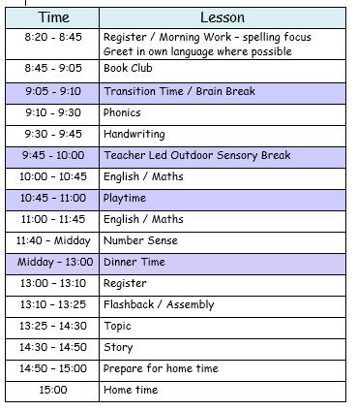
The School Day 8:20am - 3pm

Slide 4
Statutory
The early years children follow the Early Years Foundation Stage Statutory Framework.
Our Key stage One children follow the National Curriculum.

Slide 5
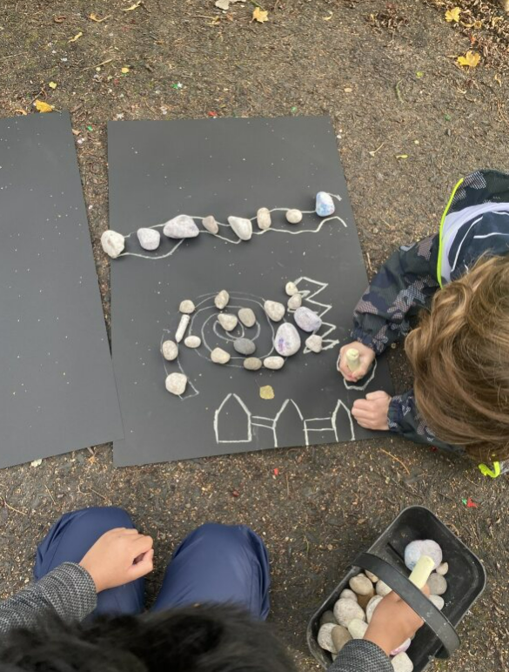
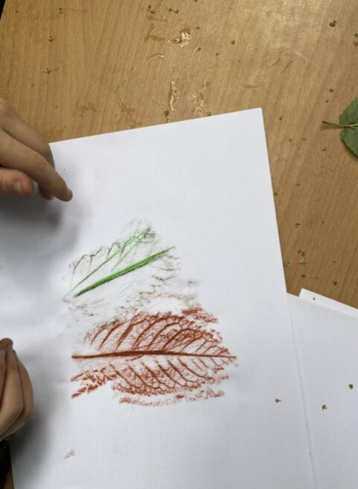
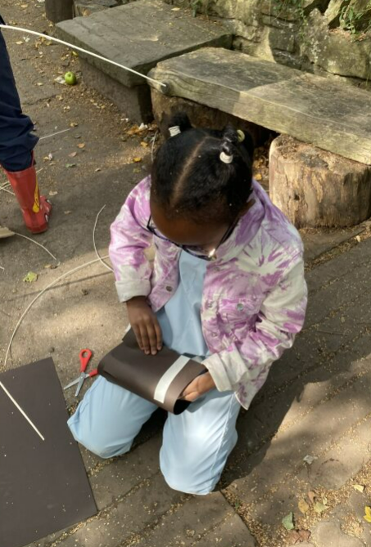
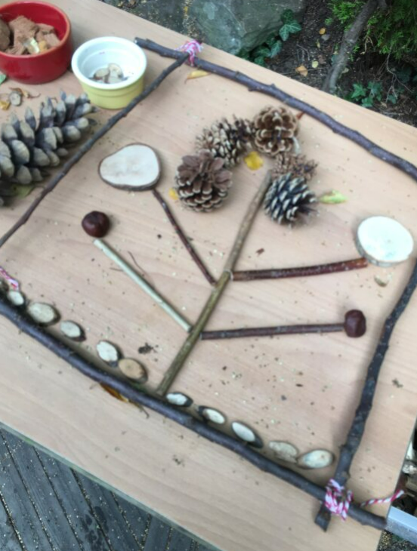
Each class has one day of Forest School every week.
Teachers and our Forest School practitioner plan closely
together.
This half term we
are teaching all of
our Art in the garden, alongside other subjects such as Science and Music.
Forest School is the golden thread that weaves its way through the curriculum.

Slide 6
The National Curriculum
The National Curriculum for Key Stage One is
defined by subjects.
For each subject, there is knowledge and skills
that need to be taught.
English, maths and science are split into
year 1 and 2.
Other subjects have end of KS1 objectives.

Slide 7
Schemes That We Use
We have invested in schemes of learning. The ones we use are approved by the Department for Education. This reduces workload for the subject leaders and provides school with quality planning and resources to follow.
We use:
White Rose Maths Scheme
Sheffield SACRE Scheme (Standing Advisory Council for Religious Education) - the children will learn from the principal religions represented in the UK; Christianity, Islam, Hinduism, Sikhism, Buddhism, Judaism
Jigsaw - which covers Personal, Social, Health and Economics as well as Relationships and health education.

Slide 8
Schemes That We Use
Little Wandle Phonics Scheme
We buy into the Arches School Sport Partnership Programme and follow the Get Set 4 PE scheme.
Out of the Ark Music Scheme
Teach Computing Scheme

Slide 9
Our Subject Leaders
Subject/s | Subject Leader
Jane Barnes Headteacher | Designated Safeguarding Lead / Designated Mental Health Lead / Pupil Premium Lead / Attendance Officer / Security Lead
Jo Jones Deputy Head | English / Art / Special Educational Needs Coordinator
Matt Shaw | Reading/ Phonics
Susan Jones Key Stage 1 Lead | Geography / History / Design and Technology
Gail Hutt | Music / Religious Education / Spiritual, Moral, Social, Cultural / Personal, Social, Health and Economic
Alice Craven | Science
Helen Downham Early Years Lead | Maths
Corey Clarke | Physical Education
Sarah Hawley | Computing

Slide 10
Ofsted Focus
The focus is currently on the Intent, Implementation and Impact of the curriculum.
Intent – What we intend to teach your children.
Implementation – The teaching!
Impact – Do the children know more? Can they do more? Do they remember more?
Tell me and I’ll forget. Show me and I’ll remember.
Involve me and I’ll understand.

Slide 11
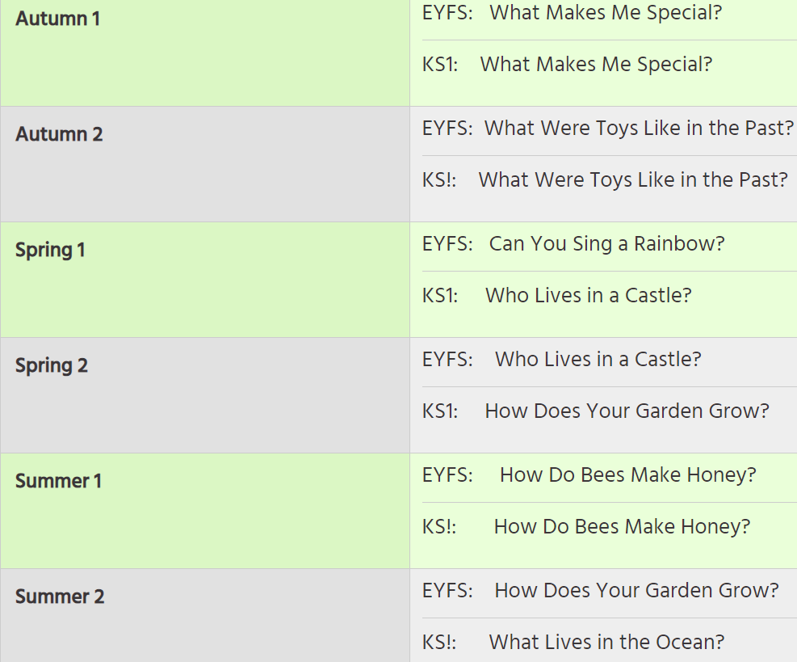
Intent - Our Learning Challenge Curriculum Questions
We have a two year teaching cycle.

Slide 12
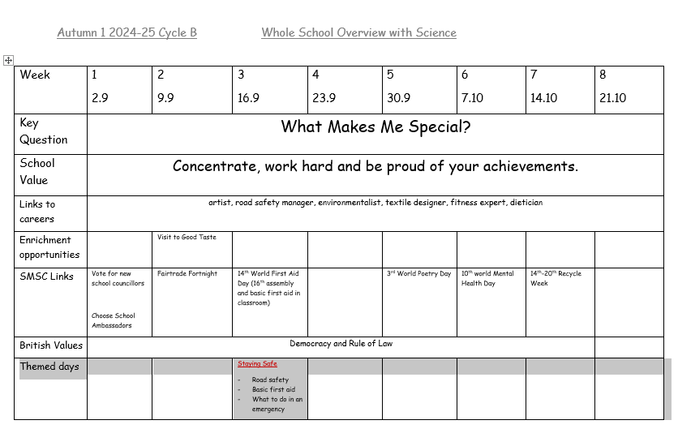
Intent - Medium Term Plans. An example…

Slide 13
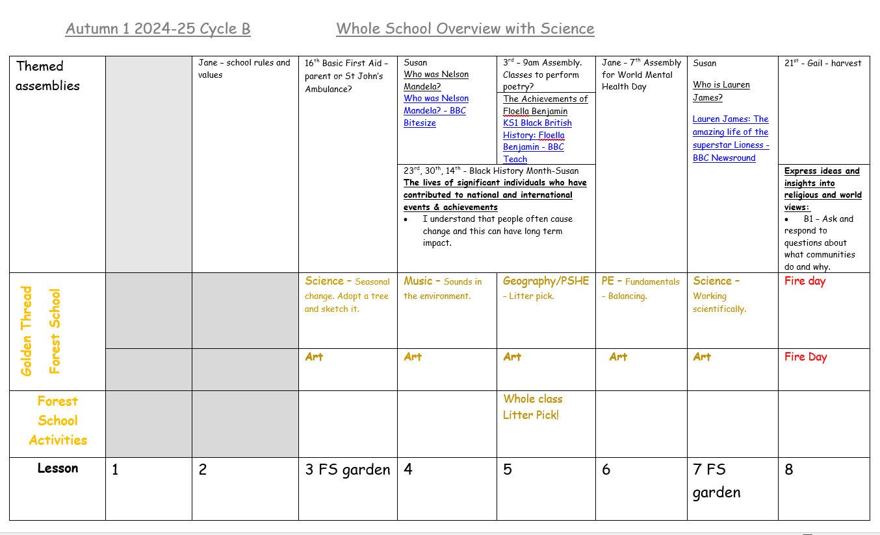
Intent - Medium Term Plans. An example…

Slide 14
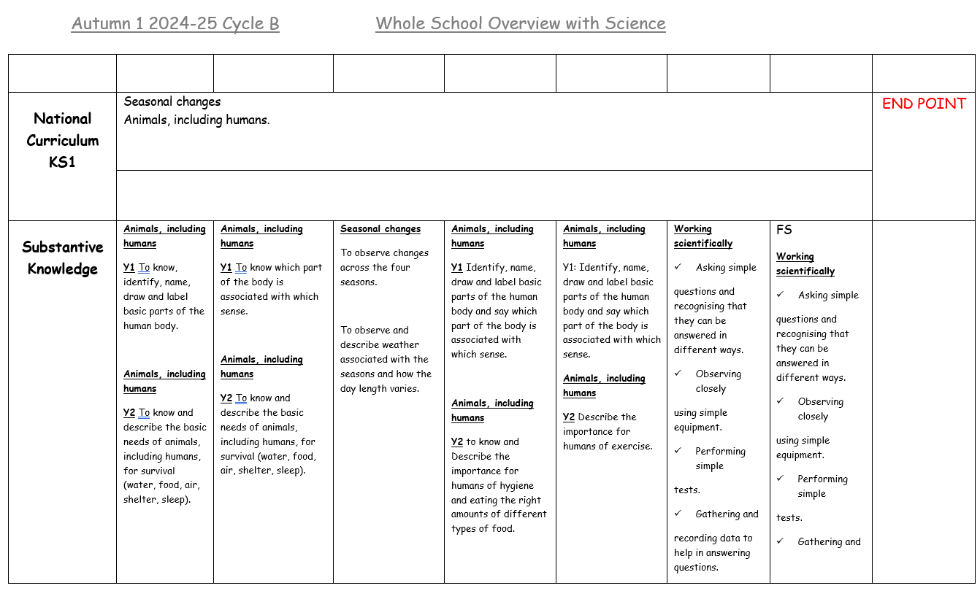
Intent - Medium Term Plans. An example…

Slide 15
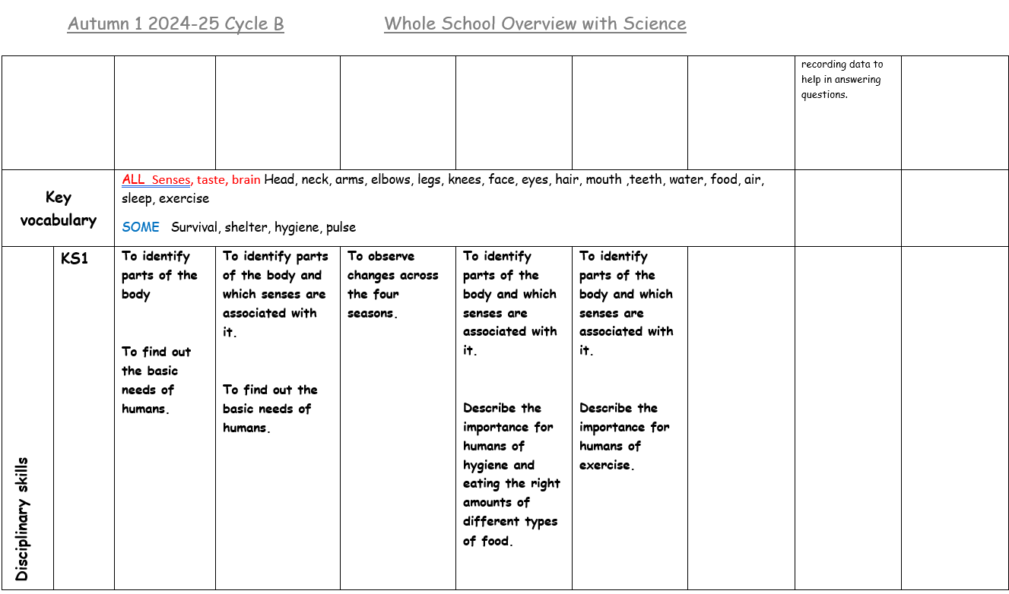
Intent - Medium Term Plans

Slide 16
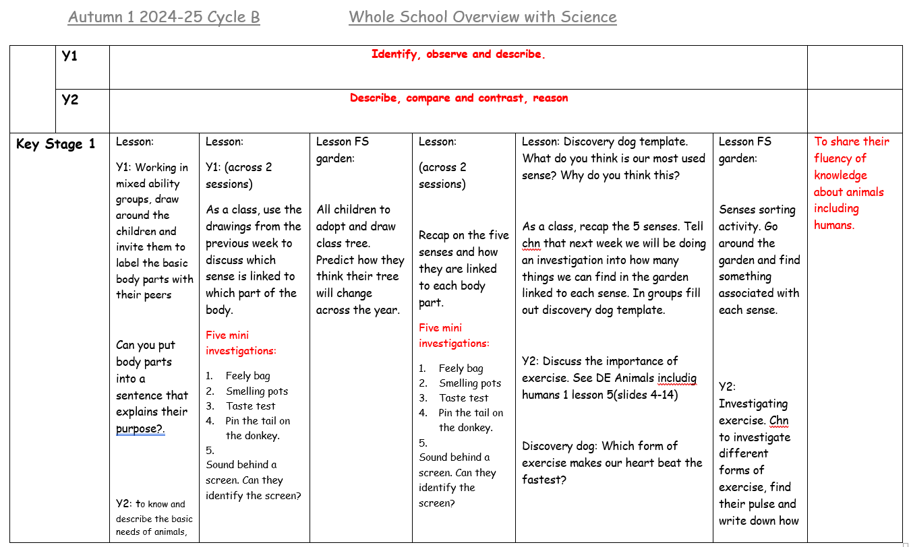
Intent - Medium Term Plans

Slide 17
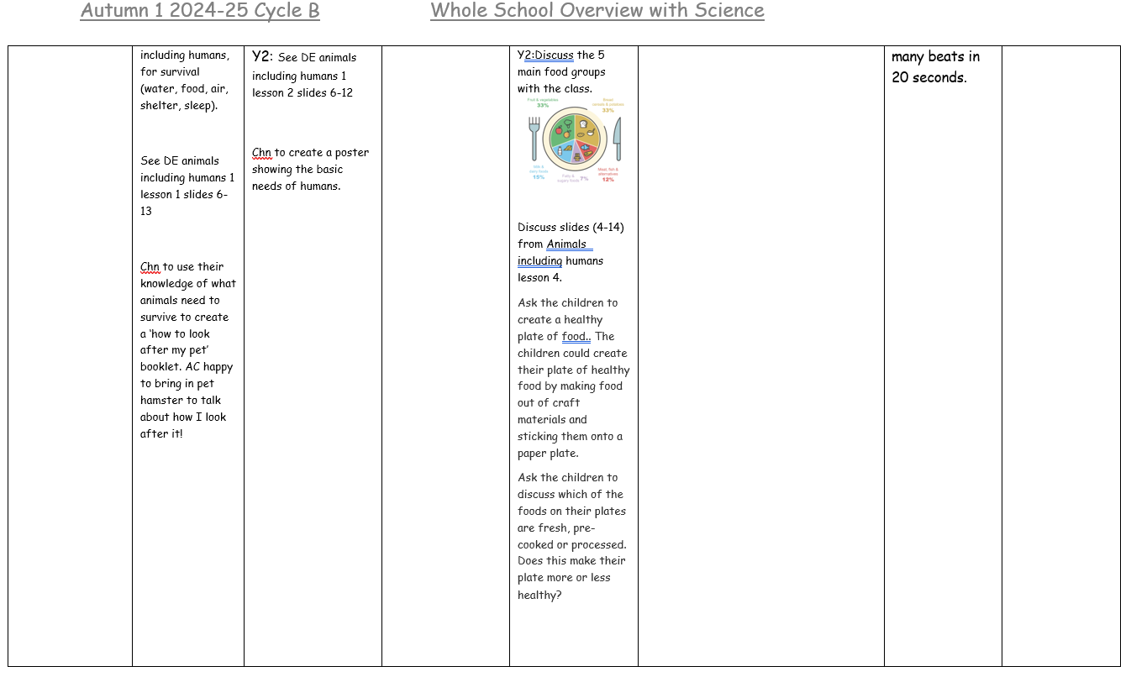
Intent - Medium Term Plans

Slide 18
Impact
The subject leader will:
Check that evidence matches exactly to the intent.
Check that the children have retained and can recall what they
have learned.
Ensure that any gaps are filled with intervention groups or by re-teaching for those children who haven’t retained the learning.

Slide 19
Assessment
Teachers do formative assessments daily, in every
lesson. This might be in the form of questioning,
quizzes, whiteboards, flashcards, etc. They also conduct Flashback sessions to see what the class has retained.
Summative assessment is done at the end of a block of learning and will involve measuring the retention and recall of previous learning.
Statutory assessments are the Reception Baseline and Year 1 Phonics Screening Check.
SATs are no longer statutory in Year 2.

Slide 20
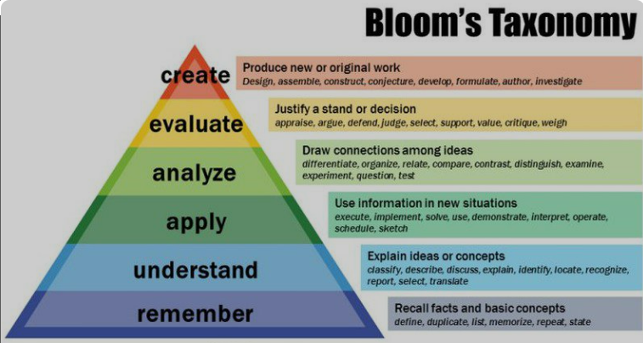
Challenge – Higher Order Thinking.
Questioning
Extension
activities
Problem
solving
Flashbacks

Slide 21
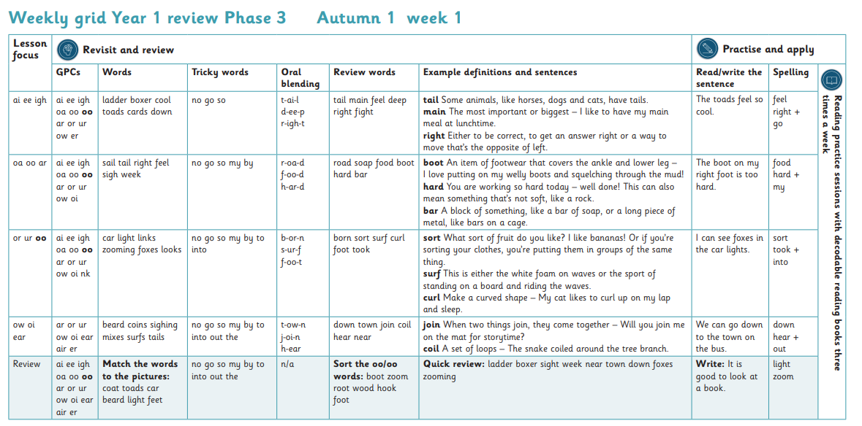
How We Teach Phonics

Slide 22
The Phonics Screening Check – w/c 9th June 2025

Slide 25
Year 2
By the end of year 2, your child will have completed the key stage 1 curriculum.
At the end of the year the children will be assessed as working:
WTS – working towards the expected standard
EXS – working at age related standard
GD – working at greater depth within the standard

Slide 26
Reading
Reading – focus on fluency and comprehension.
Book Club - replaces guided reading. The children read in
small groups, all of whom are at the same reading level.
It has two important purposes; one is to hear
every child read every day and the other is to focus on a
different reading comprehension skill each day; Prediction, Retrieval, Inference, Vocabulary and Sequencing.

Slide 27
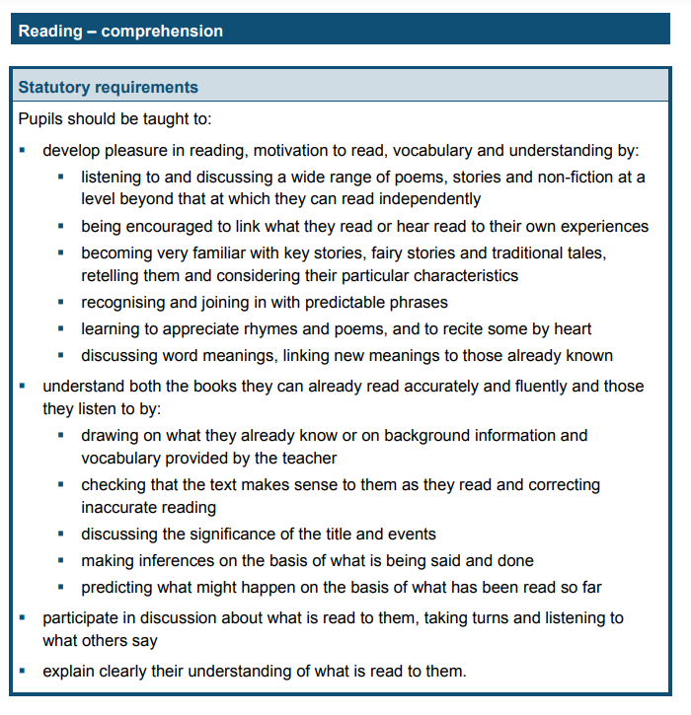
Reading

Slide 28
English
Phonics – We follow the Little Wandle scheme. Phonics is taught everyday.
Writing – we follow the teaching sequence:
immerse – analyse – skills – plan – write – edit
We are having a big push on letter formation, handwriting and presentation skills.

Slide 29
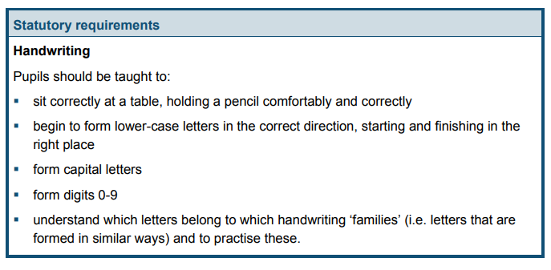
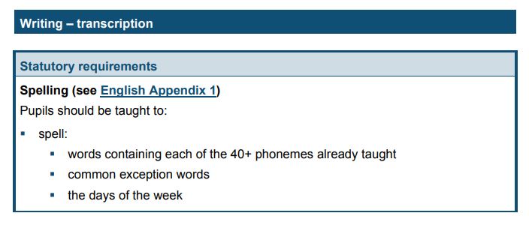
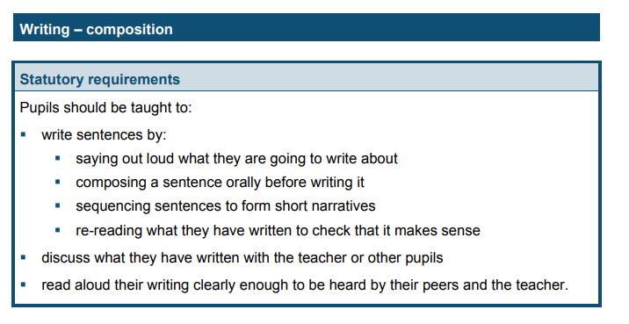
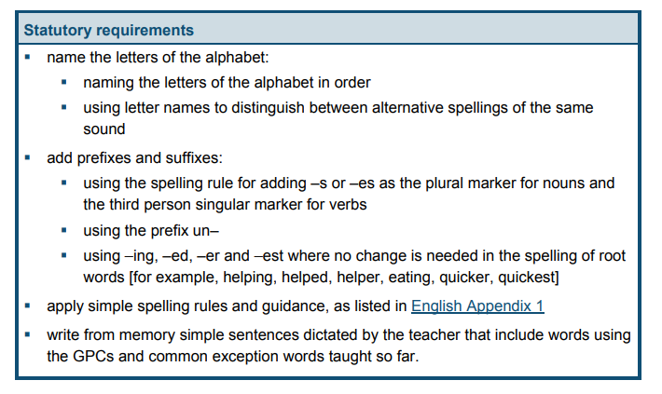
English
.

Slide 30
Maths
We move the children from:
practical – pictorial – abstract
We spend as much time as the children need on each aspect
to embed new learning and key concepts.
We do daily mental and oral sessions to rehearse mental calculation knowledge and number facts.

Slide 31
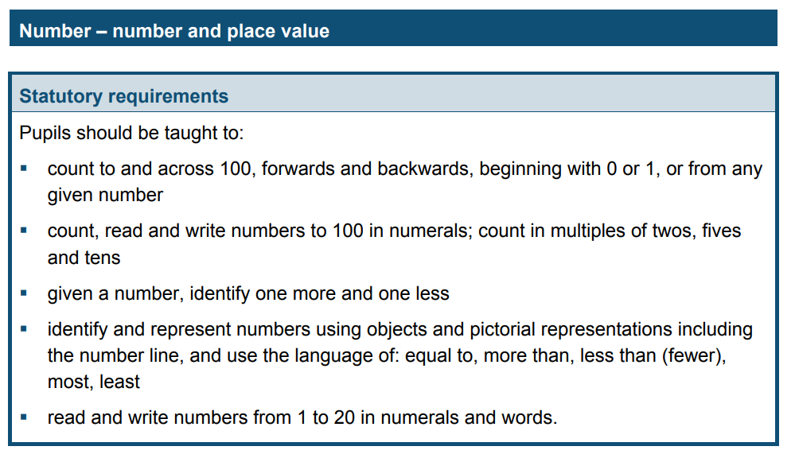
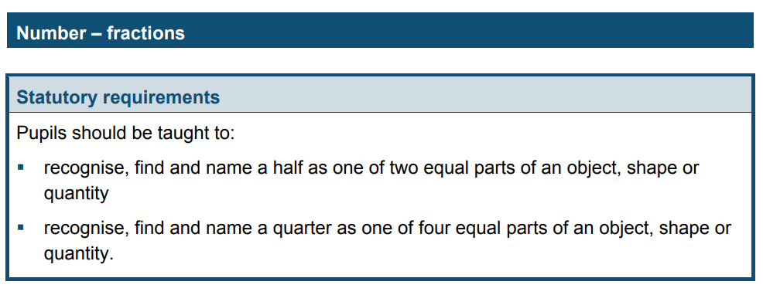
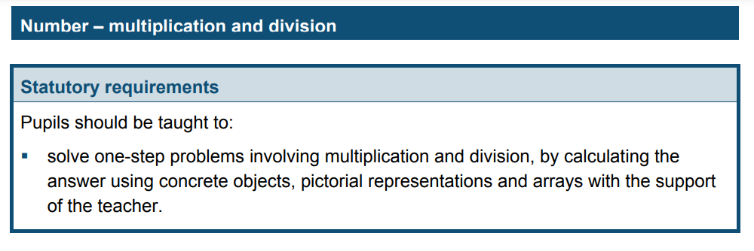
Maths

Slide 32
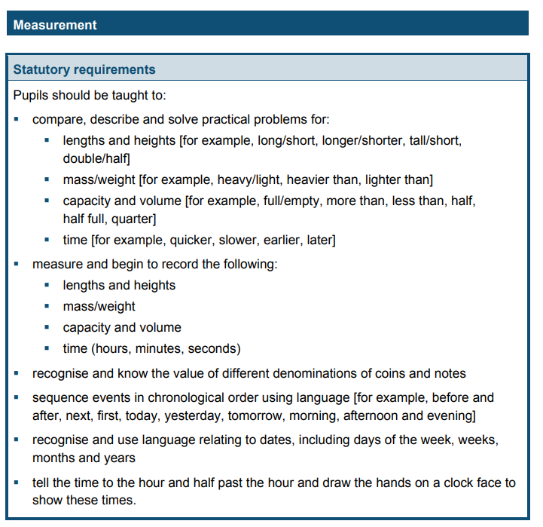
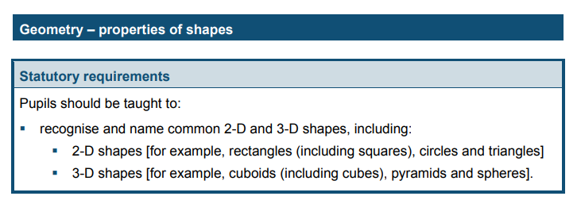
Maths

Slide 33
How can You Get Involved?
You can help your child in a variety of ways:
Listen to your child read every day.
Read to your child regularly - reading quality texts to your child
will enhance their vocabulary.
Problem solve with your child.
Spend quality time with your child and have fun!

